Slide 1
Embedded Final Project SBE403
Prepared by : Team 4

Slide 2
TOC
ATmega32 Microcontroller
LM016 Character LCD
TC72 SPI to Temperature Convertor
(4 * 3) Keypad
PWM to Voltage Convertor Module
Calibration Resistor
Full Schematic (Proteus)
Problem/s Faced

Slide 3
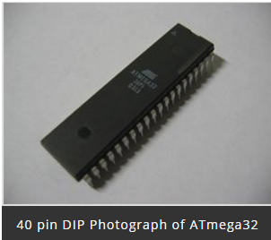
ATmega32-8 Bit AVR MicroController
ATmega32 microController is a low power CMOS technology based controller. Due to RISC architecture AVR microcontroller can execute 1 million of instructions per second if cycle frequency is 1 MHz provided by crystal oscillator.

Slide 4
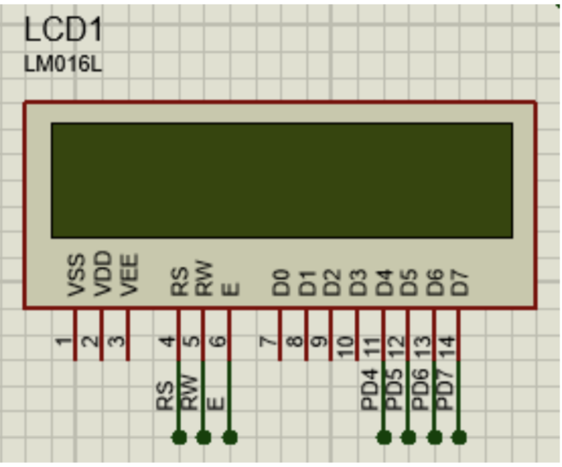
LM016 Character LCD
LCD:
LCDs (Liquid Crystal Displays) are used for displaying status or parameters in embedded systems. LCD (16 * 2) is a 16-pin device which has 8 data pins (D0 - D7) and 3 control pins (RS, RW, EN). The remaining 5 pins are for supply and backlight for the LCD. The control pins help us configure the LCD in command mode or data mode. They also help configure read mode or write mode and when to read or write. LCD 16x2 can be used in 4-bit mode or 8-bit mode depending on the requirement of the application. To use it, we need to send certain commands to the LCD in command mode and once the LCD is configured according to our need, we can send the required data in data mode.

Slide 5
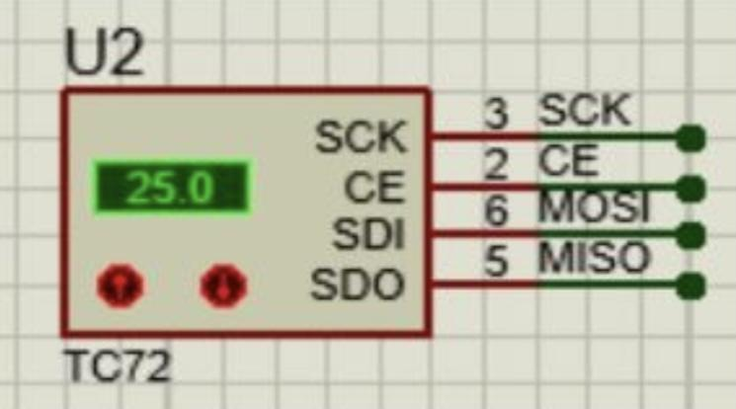
TC72 SPI to Temperature Convertor
SPI Communication
The Serial Peripheral Interface (SPI) is a bus interface connection protocol originally started by Motorola Corp. It uses four pins for communication.
SDI (Serial Data Input)
SDO (Serial Data Output)
SCLK (Serial Clock)
CS (Chip Select) euismod.

Slide 6
Programming For TC72
The overall programming interface lists below:
Set up the SPI to master mode
Select SPI clock and data sampling mode
Set up digital output for display
Send the command to TC72
Read temperature from TC72
Display the Result

Slide 7
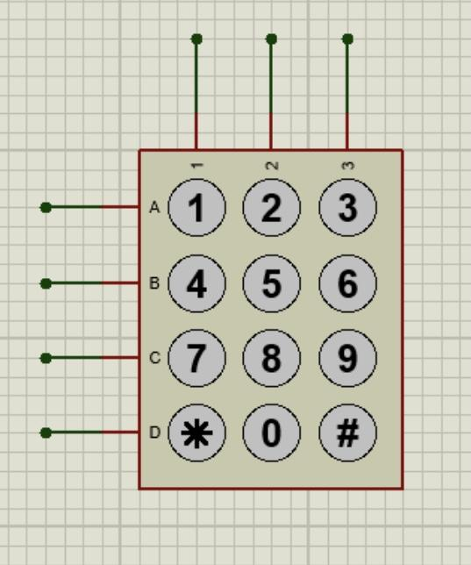
(4 * 3) Keypad
4 * 3 keypad consists of 4 rows and 3 columns. Switches are placed between the rows and columns. A keypress establishes a connection between the corresponding row and column between which the switch is placed.
To read the keypress, we need to configure the rows as outputs and columns as inputs.
Columns are read after applying signals to the rows to determine whether a key is pressed and if pressed, which key is pressed.

Slide 8
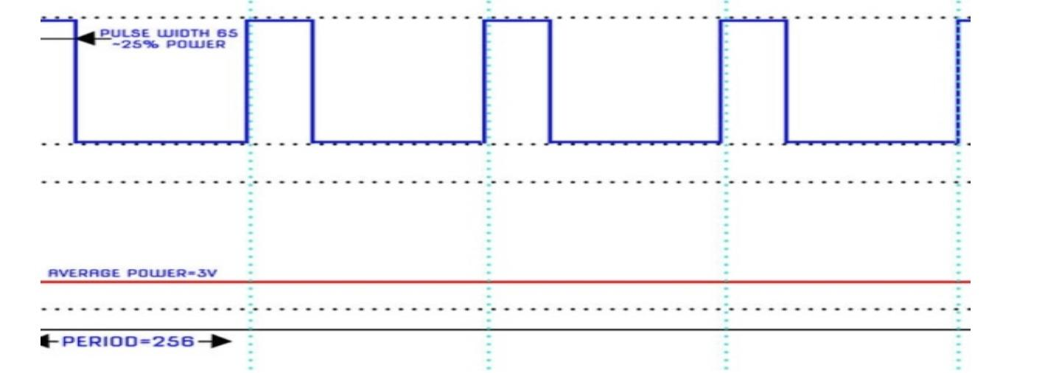
PWM to Voltage Convertor Module
Pulse Width Modulation (PWM) is a technique in power control, which used to control the power fed to control the temperature of the heater. It is a modulation technique, which have the width of the carrier pulse is varied in accordance with the analog message signal.

Slide 9
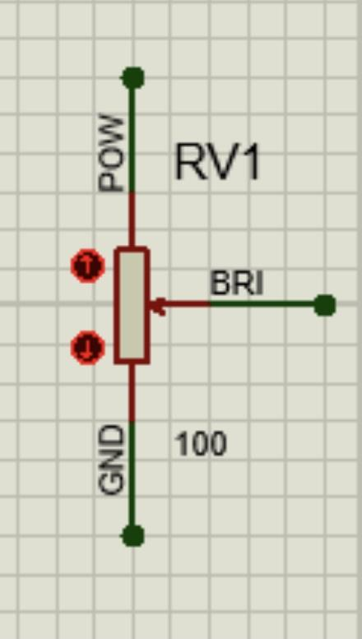
Calibration Resistor
Steps to Program ADC:
Make the ADC channel pin as an input.
Set ADC enable bit in ADCSRA, select the conversion speed using ADPS2 : 0. For example, we will select divisor 128.
Select ADC reference voltage using REFS1: REFS0 in ADMUX register, for example, we will use AVcc as a reference voltage.
Select the ADC input channel using MUX4 : 0 in ADMUX, for example, we will use channel 0.
So our value in register ADCSRA = 0x87 and ADMUX = 0x40.
Start conversion by setting bit ADSC in ADCSRA. e.g. ADCSRA |= (1<<ADSC);
Wait for conversion to complete by polling ADIF bit in ADCSRA register.
After the ADIF bit gone high, read ADCL and ADCH register to get digital output.
Notice that read ADCL before ADCH; otherwise result will not be valid.

Slide 10
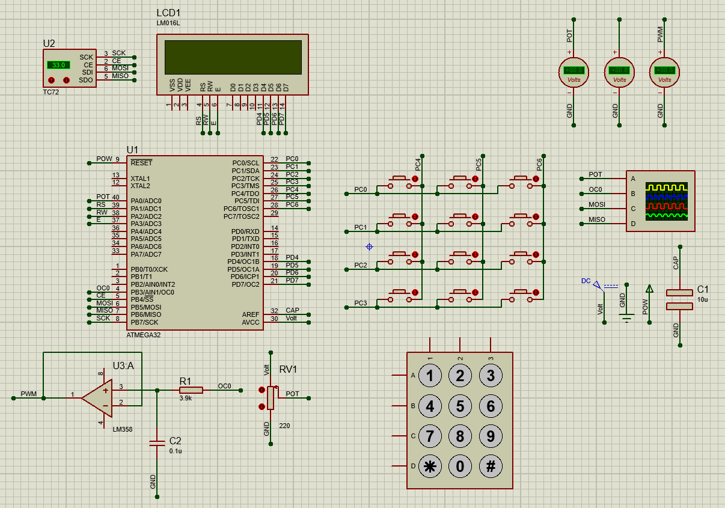
Full Schematic
(Proteus)

Slide 11
Problem/s Faced
Keypad Interface and delay (Used push buttons instead)
LCD Frequency (Set to 16 MHz as Micro-controller)
Serial Communication with infinite loop (Start SPI communication on demand)
PWM pulses were too small (Used LPF with amplification of signal)
Time Constraints (Used Timers and Interrupts) – Not Efficiently Work
All work together (Used Timers)
Operations handle (Normal, Operation, Error) – Not too bad

Slide 12
THANK YOU!

